Slide 1

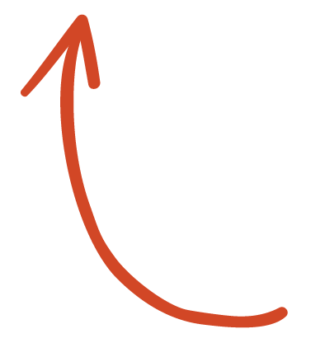
Here's your outline to get started
Key facts about your topic
A housing estate is a group of homes and other buildings built together as a single development. The exact form may vary from country to country. Accordingly, a housing estate is usually built by a single contractor, with only a few styles of house or building design, so they tend to be uniform in appearance. A housing development is "often erected on a tract of land by one builder and controlled by one management." In the British Isles, the term is quite broad, and can include anything from high rise government-subsidised housing, right through to more upmarket, developer-led suburban tract housing.
See more: Open the Notes below for more information.
Notes:
QuickStarter has created an outline to help you get started on your presentation. Some slides include information here in the notes to provide additional topics for you to research.

Slide 2
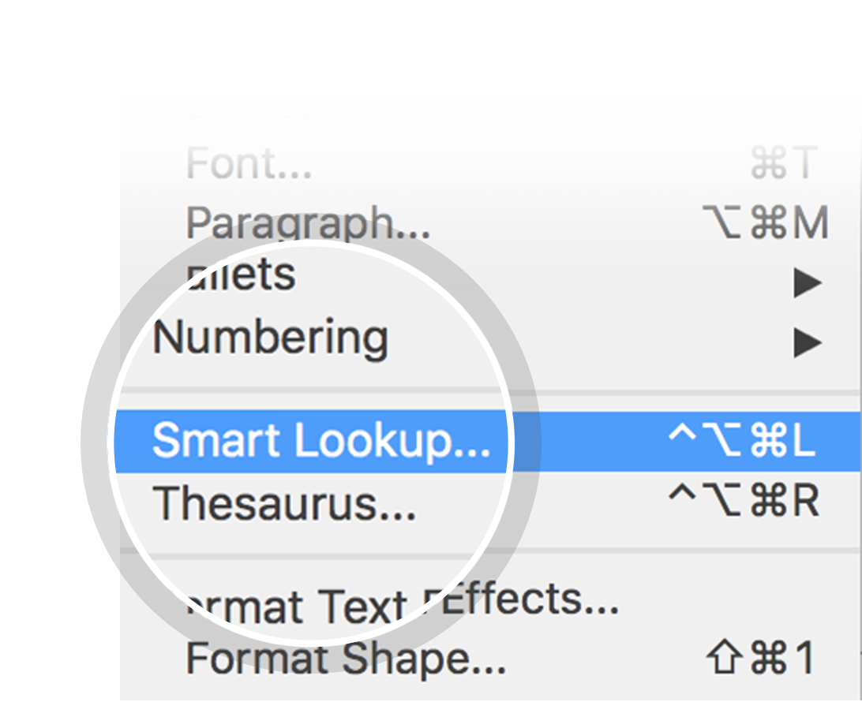
Related topics to research
Estate
Council house
Apartment
Gated Community
Severance
Daily Urban System
New Suburbanism
Use Smart Lookup to learn more
1
Highlight one of the related topics
Right-click on the topic
Choose "Smart Lookup"
2
3

Slide 3
Details and question being asked
Working as an analyst in an investment bank
Problem: How should we allocate money from our investment funds into mortgages, or MBS?
Rate of return on MBS vs other investment currently held? Threshold for such investments of either allocation?
How should we allocate dollars earmarked for investment INTO mortgage backed securities?
Meaning…. Earmarked – setting funds aside for a particular project // in this case, setting funds aside for investing
Mortgage backed securities (MBS) – a variation of asset backed securities (a financial investment that is collateralized by an underlying pool of assets. Ones that generate cashflow from debt like loans, leases, and credit card balances). An investor who buys a MBS is essentially lending money to home buyers, typically bought and sold through a broker.
Most importantly, What are the factors that drive home prices?

Slide 4
Grading rubric
Excel workbook with data analyses?
Provided solution to business objective for end user?
One visualization for each test that helped advance the story?
Did the student run two or more tests for statistical significance?
Relevant indicators, such as p-values and confidence intervals to support hypotheses?
Analysis relevant to the data the student was analyzing and the hypothesis they were trying to test?
With t or z-test, were the sample sizes for each sample tested appropriately?
Were results of tests stated in the workbook?
Are the PP slides formatted in a way that’s organized and easy to understand?
Did the student’s PP slides cover each step of the analysis (intro, hypo, data, methods. Results, recommendations)?
Did the PP slides clearly communicate insights that inform decision making?
Did PP slides include business objective/project goal at the beginning and a call to action/recommendation at the end?
PP slides appropriate for mixed audience of technical and non-technical business partners?

Slide 5
Factors that drive Home prices
Corey Hawkins
Thinkful Capstone #2

Slide 6
Introduction
What makes this topic interesting is the use of statistical research to back decisions we’re making in the housing market as an investment bank. We each have unique interests when it comes to things we look for when purchasing a home, but do these factors translate into the final sale price? We will address the following questions with descriptive and differential statistics:
As an investment bank, how should we allocate money from our investment funds into mortgages, or MBS?
Our business objective is to invest in mortgages of homes where factors influencing sale price are greatest.
Most importantly, What factors drive home prices?
Factors we will be exploring in this presentation include:
Building type – Do single-family building types influence sale price greater than other building types?
House style - Do 2 Story house types affect sale price greater than all other building types?
Neighborhood – Does North Ridge neighborhood affects sale price greater compared to all other neighborhoods?
Kitchen quality – Does "Excellent" kitchen quality influence sale price greater than "Good" kitchen quality?
Sale condition – Do "Normal" sale conditions influence sale price greater than "Partial" sale conditions?

Slide 7
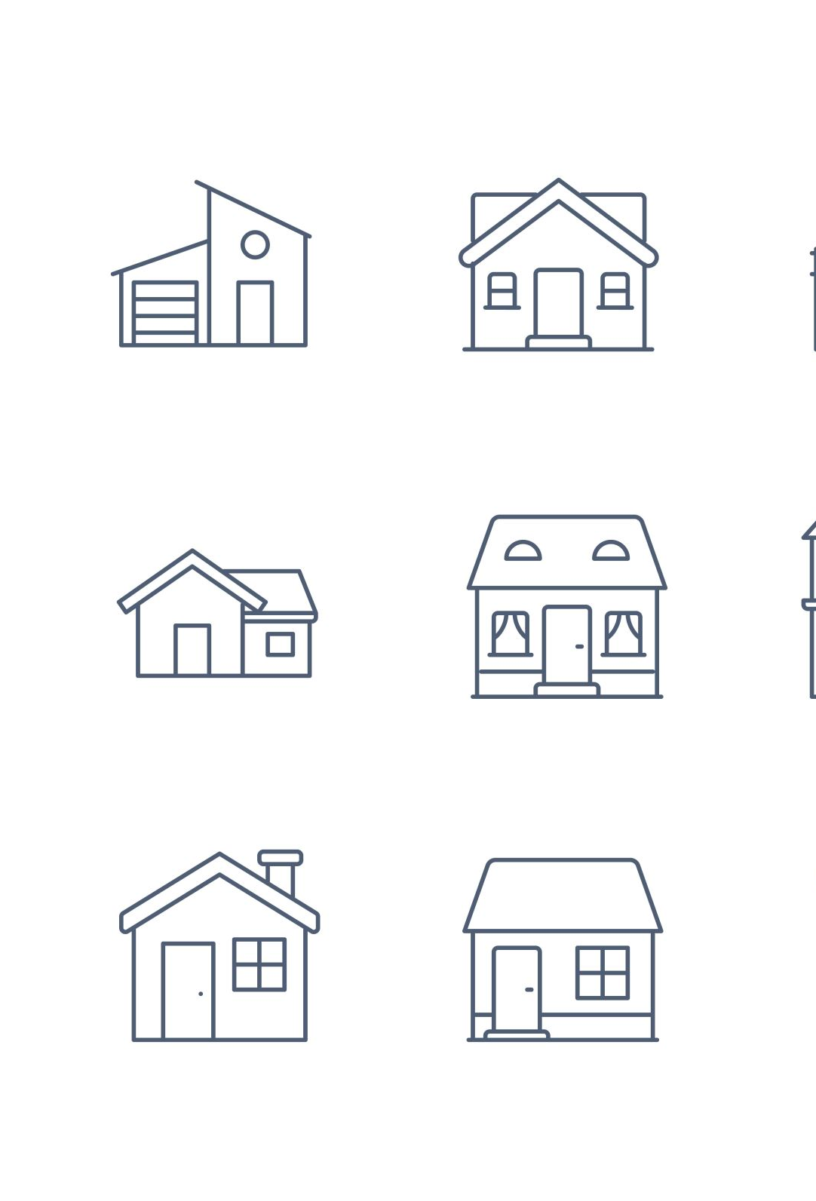
Hypotheses
There are 5 categories we are testing:
Building type: Null (Ho): Single family building types affect sale price than all other building types Alternative (Ha): Building type does not affect sale price
House Style: Null(Ho): 2 Story house types affect sale price than all other building types. Alternative (Ha): House style type does not affect sale price
Neighborhood: Null (Ho): The North Ridge neighborhood affects sale price compared to all other neighborhoods. Alternative (Ha): Neighborhood type does not affect sale price compared to other neighborhoods
Kitchen Quality: Null (Ho): "Excellent" kitchen quality vs. "Good" kitchen quality affects sale price. Alternative (Ha): "Excellent" kitchen quality vs. "Good" kitchen quality does not affect sale price
Sale Condition: Null (Ho): "Normal" sale conditions vs. "Partial" Sale conditions influence sale price. Alternative (Ha): "Normal" sale conditions vs. "Partial" sale conditions does not influence sale price.

Slide 8
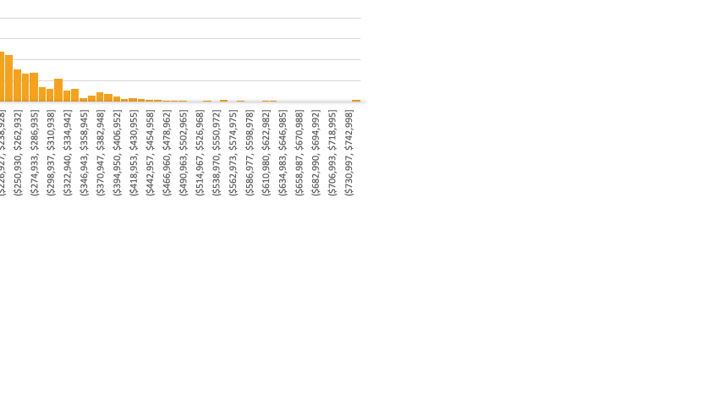
Data
This dataset was collected from Kaggle.com, consisting of 79 explanatory variables, describing most aspects of residential homes in Ames, Iowa. This dataset was designed for a competition to predict the final price of each home. This housing dataset was compiled by Dean De Cock for use in data science education.
Descriptive Stats
Mean | $ 180,921
Standard Error | $ 2,079
Median | $ 163,000
Mode | $ 140,000
Standard Deviation | $ 79,443
Sample Variance | 6311111264
Kurtosis | 6.53628186
Skewness | 1.88287576
Range | $ 720,100
Minimum | $ 34,900
Maximum | $ 755,000
Sum | $ 264,144,946
Count | 1460
Sale prices are normally distributed

Slide 9
Methods
I conducted independent-samples t-test for multiple H_{o} . To do this, I utilized A/B testing and split the data into treatment and control groups using Excel's pivot table filtering and Analysis ToolPak. Confidence intervals along with the p-values are used to provide both statistical and substantive measures. Group means with confidence interval were plotted.
XLOOKUP was used to match the original dataset variable descriptors to a full description of each column for better understanding during this presentation.

Slide 10
Results: building type
Reject the Null hypothesis that there is no difference between the population means of Single-Family Detached Building Type vs all other building types
The difference is significant at the <0.05 level, where p= 1.12361E-11. With 95% confidence, the difference is between $21,140 & $37,779.

Slide 11
Results: House style
Reject the Null hypothesis that there is no difference between the population means of 2-Story House style type vs all other house style types.
The difference is significant at the <0.05 level, where p= 5.28981E-18. With 95% confidence, the difference is between $32,637 & $51,167.

Slide 12
Results: Neighborhood
Reject the Null hypothesis that there is no difference between the population means of the North Ridge Neighborhood type vs all other neighborhood types.
The difference is significant at the <0.05 level, where p= 2.32268E-10. With 95% confidence, the difference is between $120,340 & $197,329.

Slide 13
Results: Kitchen quality
Reject the Null hypothesis that there is no difference between the population means of "Excellent" kitchen quality in comparison with "Good" kitchen quality
The difference is significant at the <0.05 level, where p= 9.42889E-16. With 95% confidence, the difference is between $91,917 & $140,960.

Slide 14
Results: Sale condition
Reject the Null hypothesis that there is no difference between the population means of ”Normal" sale condition in comparison with ”Partial" sale condition. Where Normal sale, by definition, is a normal sale and a partial sale is a home that was not completed when last assessed.
The difference is significant at the <0.05 level, where p= 1.43988E-18. With 95% confidence, the difference is between -$115,859 & -$78,320.

Slide 15
Recommendations
Our business objective is to invest in mortgages of homes where factors influencing sale price are greatest. Based on the results, we’ll make a recommendation from each tested factor.
Building type: Single family building types affect sale price more positively than all other types of buildings. It is recommended to invest in mortgages that consist of single-family detached households. These homes sell for approx. $185K in comparison with other building types that sell for approx. $156K on average.
House Style: 2 Story house types affect sale price more positively than other building types. But, It is recommended to invest in mortgages that consist of 2.5-Story Finished households. These homes sell for approx. $220K where 2-Story house styles sell for approx. $210K on average.
Neighborhood: The North Ridge neighborhood affects sale price more positively than all other neighborhoods. It is recommended to invest in mortgages that consist of the North Ridge neighborhood. These homes sell for approx. $335K in comparison with other neighborhoods that sell for approx. $176K on average.
Kitchen Quality: "Excellent" kitchen quality affects sale price more positively than "Good" types. It is recommended to invest in mortgages that consist of Excellent kitchen quality rated homes. These homes sell for approx. $328K in comparison with other homes containing “Good” quality kitchens that sell for approx. $212K on average.
Sale Condition: "Normal" sale conditions affect sale price more negatively than "Partial" Sale conditions. It is recommended to invest in mortgages that consist of Partial sale conditions. These homes sell for approx. $272K in comparison with other homes containing “Normal” sale conditions that sell for approx. $176K on average.

